Slide 1

Customer Churn Prediction and Analysis
Insights and Methodologies
B. SRI VAISHNAVI
234G5A3214
Department of Computer Science and Engineering (Data Science)
III B.tech – I sem
(2024-25)

Slide 2

Abstract
This project focuses on predicting customer churn, where customers stop using a service, using machine learning techniques. Churn prediction helps companies identify at-risk customers and take action to retain them. By analyzing customer behavior and service usage, the model provides insights that support better business decisions and improve customer retention strategies.

Slide 3
Introduction
Why is Churn Prediction Important?
Losing customers costs companies a lot of money.
It’s easier and cheaper to keep existing customers than to find new ones.
Goal: Predict customer churn using data about how they use the service.

Slide 4

Problem Definition
Many companies struggle to know which customers will stop using their service.
Identifying those likely to churn can help companies focus their efforts on retention.
The challenge: How can we predict this using customer data?

Slide 5
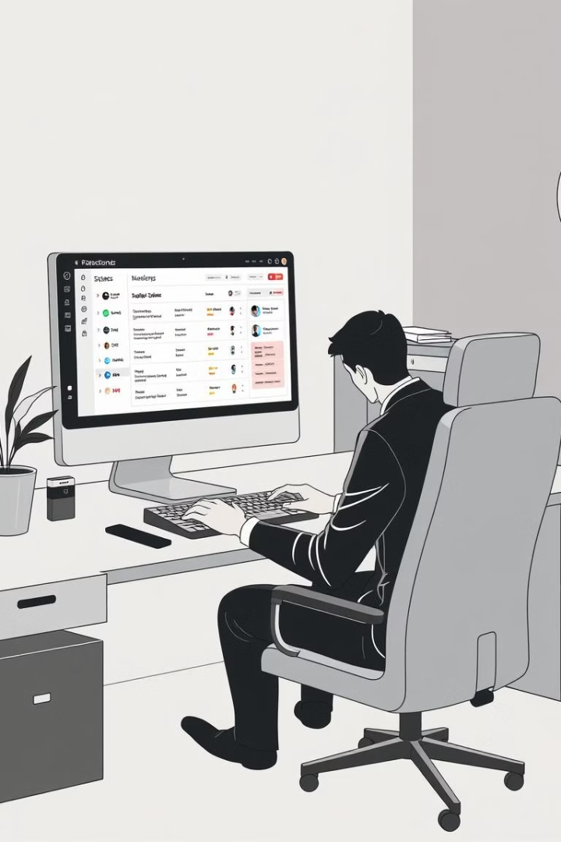
Objectives
1
Create a model that predicts churn based on customer behavior.
2
Analyze customer data to find important factors that influence churn.
3
Visualize trends in churn to help businesses understand customer behavior.

Slide 6
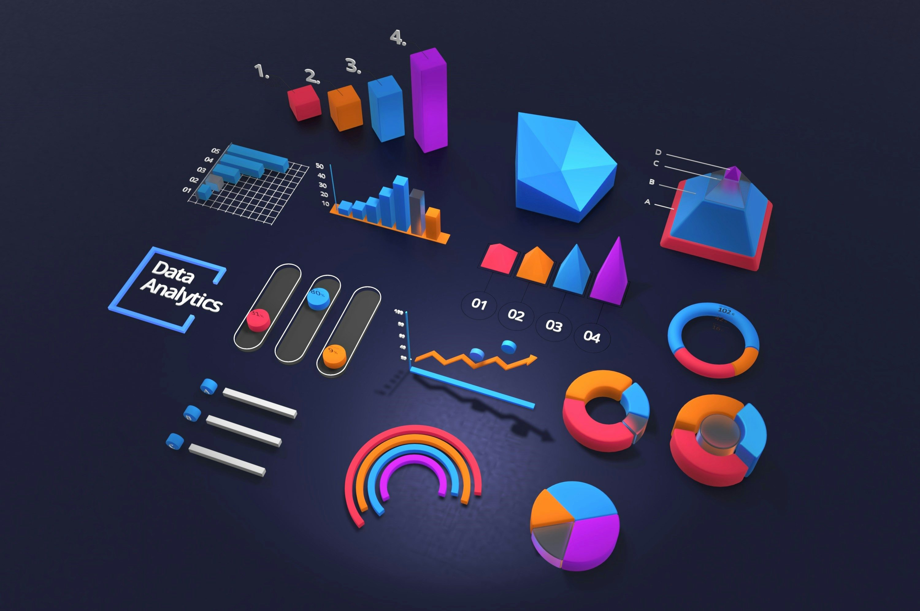
System Architecture
How the System Works:
Data Collection: Gather information on how customers use the service.
Data Preprocessing: Clean the data and prepare it for analysis.
Modeling: Use machine learning to build a prediction model.
Evaluation: Test how accurate the model is at predicting churn.
Visualization: Create charts to understand key churn patterns.

Slide 7
Key Features of Analysis
Identify At-Risk Customers
Plan Impact
Regional Insights
Show that customers with international plans are less likely to churn, guiding retention efforts
Highlight state-specific churn patterns, enabling targeted regional strategies.
Spot customers likely to churn based on frequent service calls.

Slide 8
Technologies Used
Python: For data analysis and building the model.
Pandas and NumPy: To manage and analyze data.
Scikit-learn: For creating and testing the prediction model.
Matplotlib and Seaborn: To visualize data and findings.
Random Forest: The machine learning model used to predict churn.

Slide 9
Conclusion and Future Scope
Final Thoughts
Churn prediction can save companies money by helping them keep customers.
Key factors like customer service calls and location affect churn.
Next Steps
Test other models to improve prediction.
Include additional customer data, such as satisfaction surveys, for deeper insights.

Slide 10
Thank you!

